Slide 1

Reproducible Machine Learning
Why and how to accomplish reproducibility in ML pipelines

Slide 2
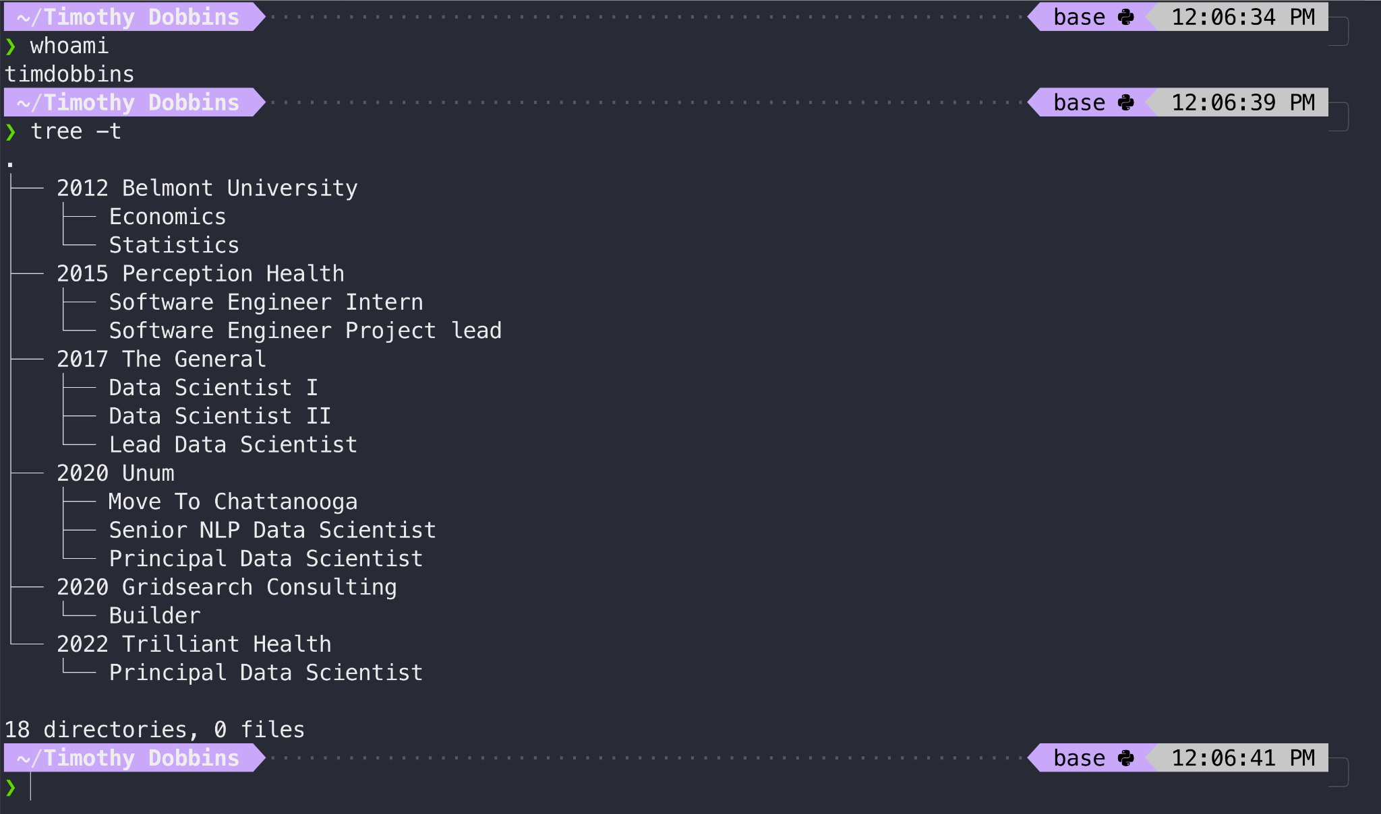

Slide 3

Who works with ML models that are in production?

Slide 4
Who works with reproducible ML models?

Slide 5
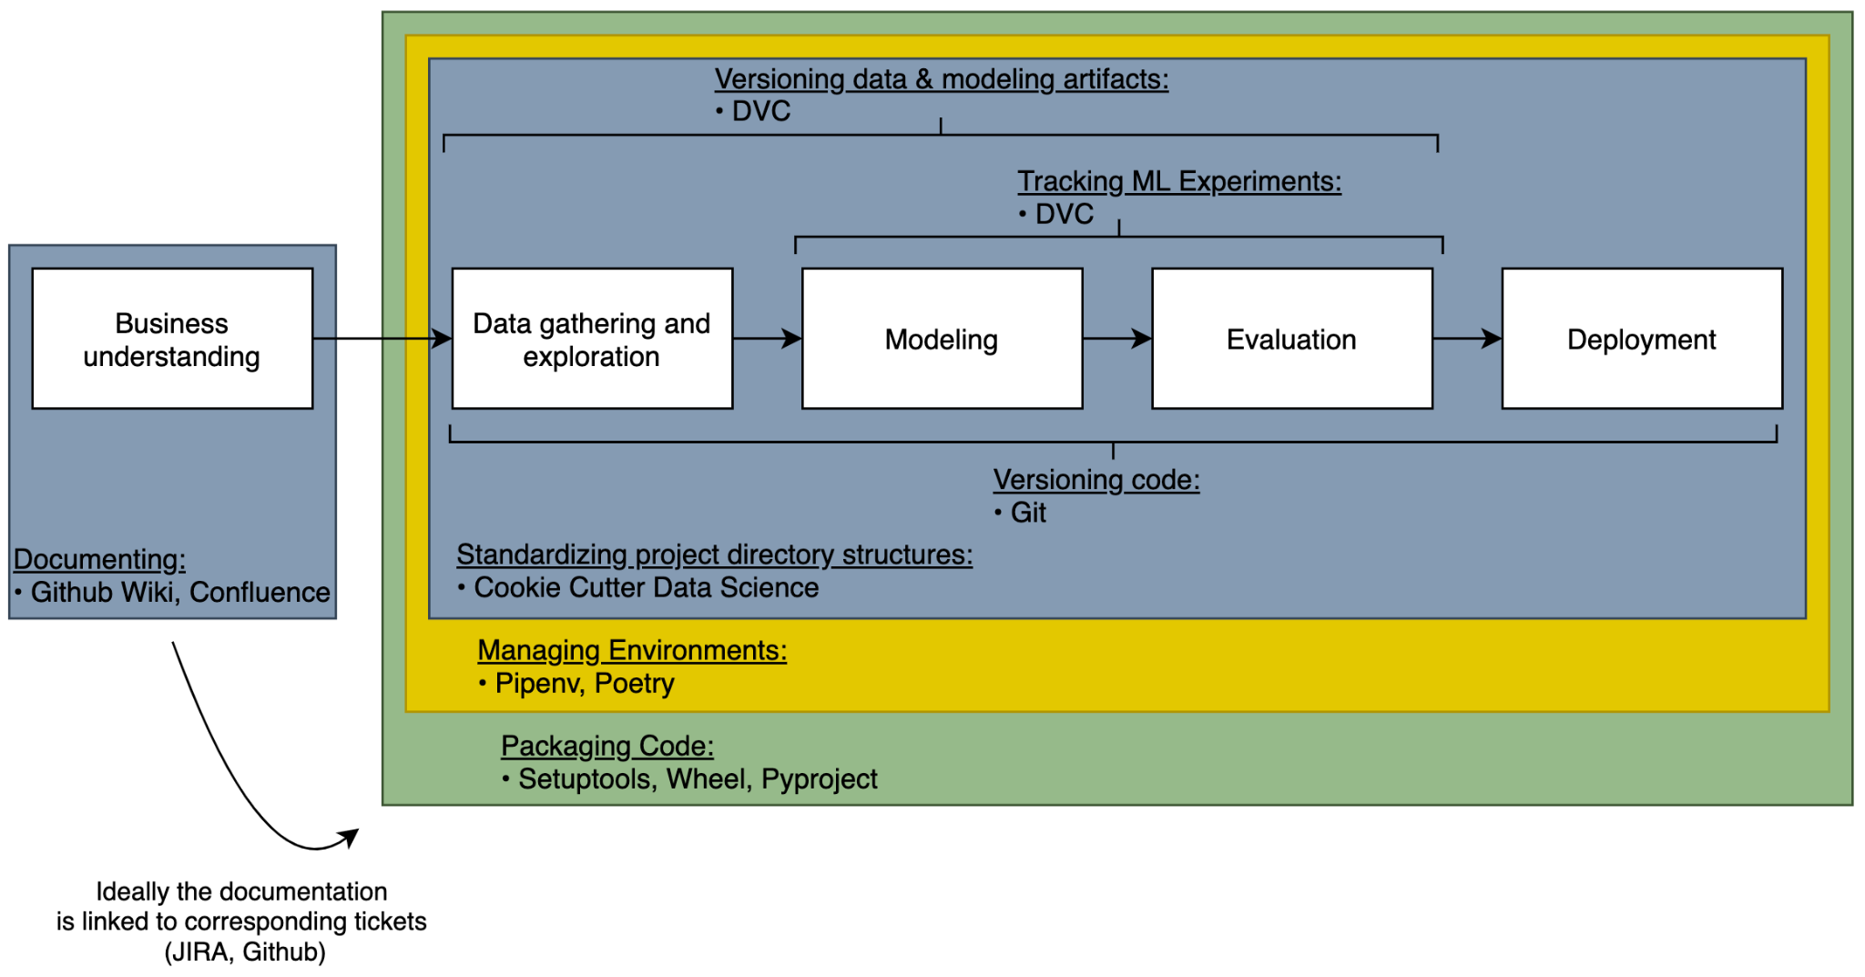
An ML reproducibility framework*
*Inspired by this framework.
Notes:
Notice no Docker. For simple applications where there’s no system-level installs, Wheel works just fine. Otherwise docker may be needed. More here: https://pythonspeed.com/articles/distributing-software/

Slide 6
Why reproducible machine learning?

Slide 7
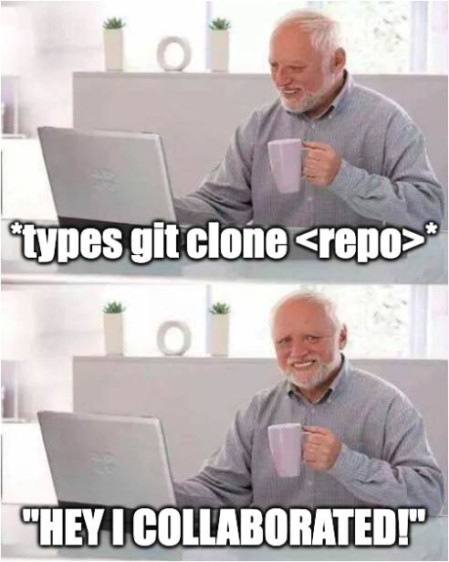

Why reproducible machine learning?
Collaborating
Notes:
To collaborate, everyone should be able to work with the same environmental dependencies with the same code and artifacts to produce the same results.
Without reproducibility, collaboration is impossible.

Slide 8

Why reproducible machine learning?
Collaborating
Debugging (remotely)
Notes:
Debugging locally is easy. It always works on my computer.
But debugging in a remote environment means you first have to get the codebase running in a non-local environment. Without reproducibility, this is untenable.

Slide 9
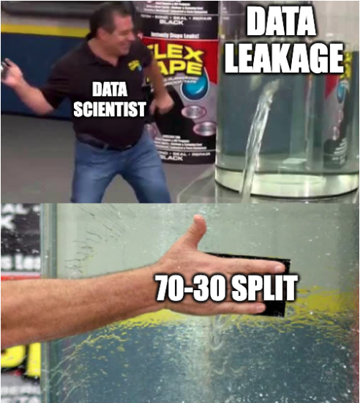
Why reproducible machine learning?
Collaborating
Debugging (remotely)
Scientifically validating
Notes:
If your data science isn’t reproducible it’s not scientific.
Whether it’s workforce that needs to forecast optimal number of workers in a given time window, claims needing to project how many cars will be total losses, or finance needing to analyze how much DS is making or saving to justify the spend, without reproducibility the numbers are unreliable. The methodology must be reproducible.
Data pipelines, transformations, training-serving skew, properly handled validation sets, tracking model trainings, hyper-parameter tuning.

Slide 10
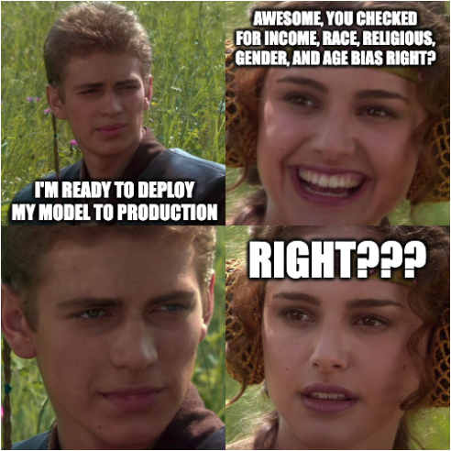
Why reproducible machine learning?
Collaborating
Debugging (remotely)
Scientifically validating
Auditing
Notes:
Whether it’s a regulatory entity approving the methodology of a model or an internal model auditing team detecting bias in an algorithm, without reproducibility audits aren’t feasible—which my be a blocker for many projects.

Slide 11
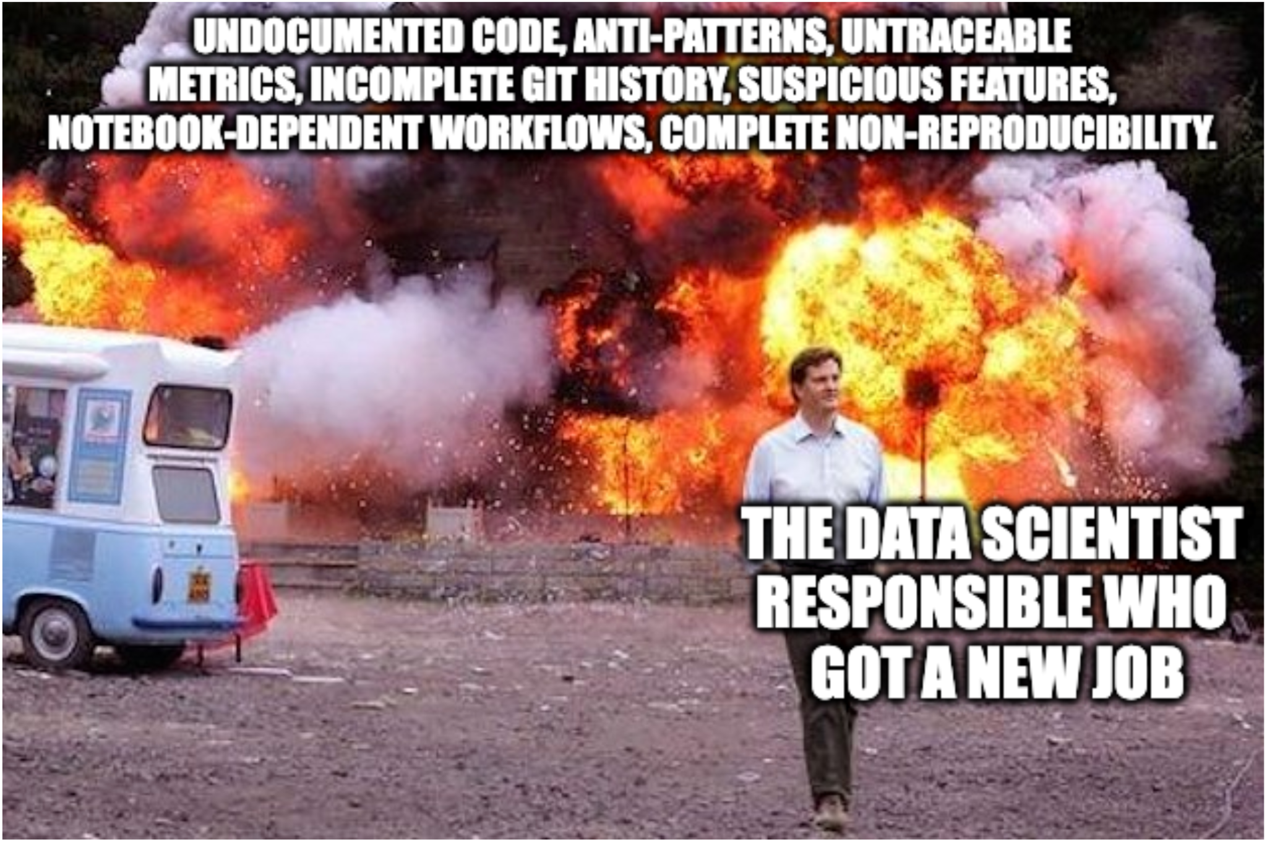
Why reproducible machine learning?
Collaborating
Debugging (remotely)
Scientifically validating
Auditing
Legacy
Notes:
Call it the Legacy rule or the Scout’s rule—code should 1) be left better than you found it and 2) in a good shape upon exiting a role.

Slide 12
How to accomplish reproducibility?

Slide 13

Four components to account for

Slide 14
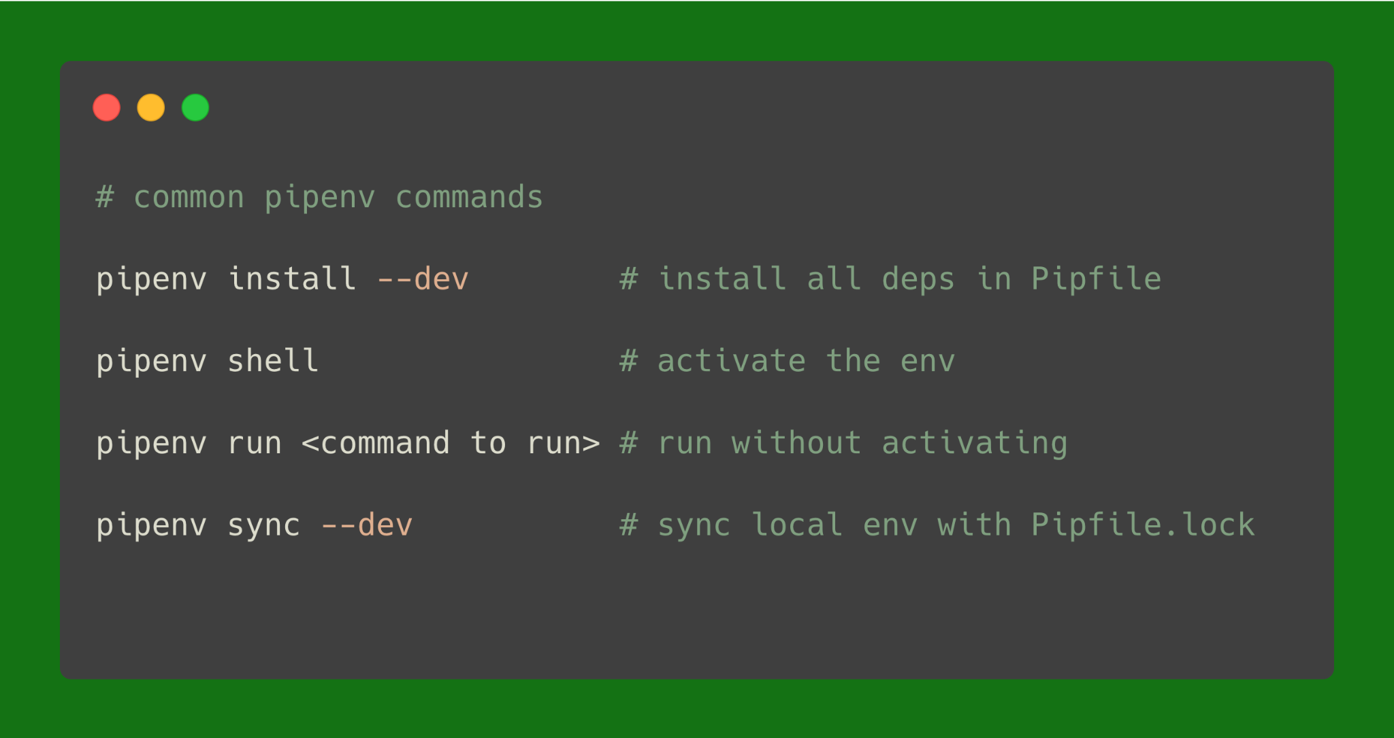
1. Environment

Slide 15
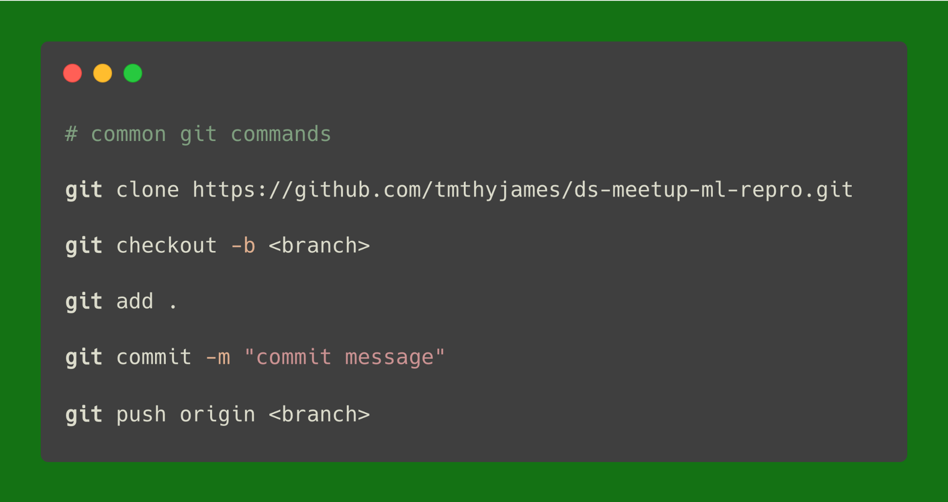
2. Code

Slide 16
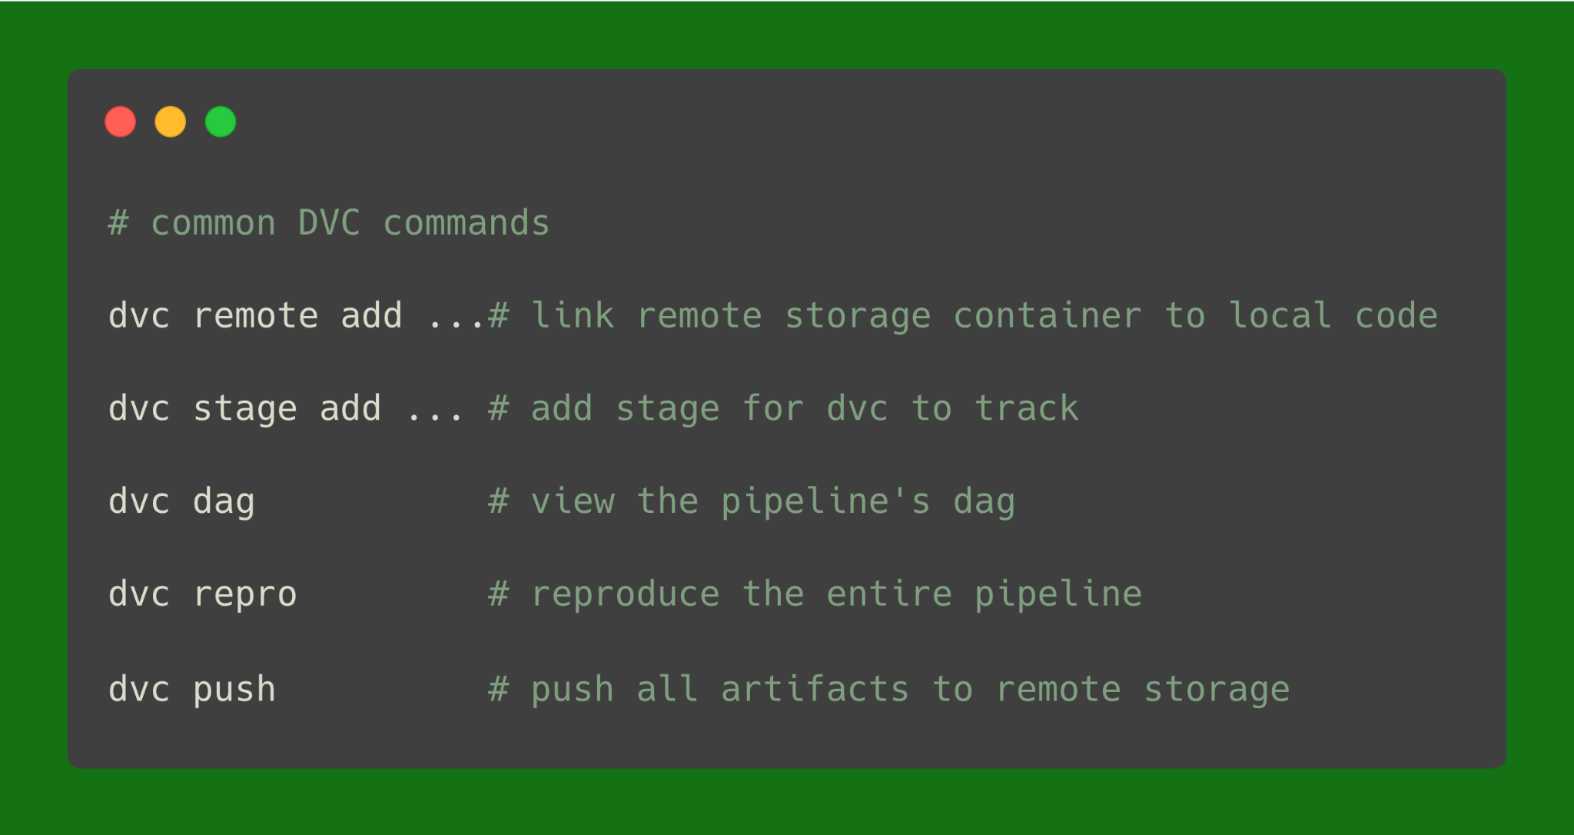
3. Data (data & model artifacts)

Slide 17
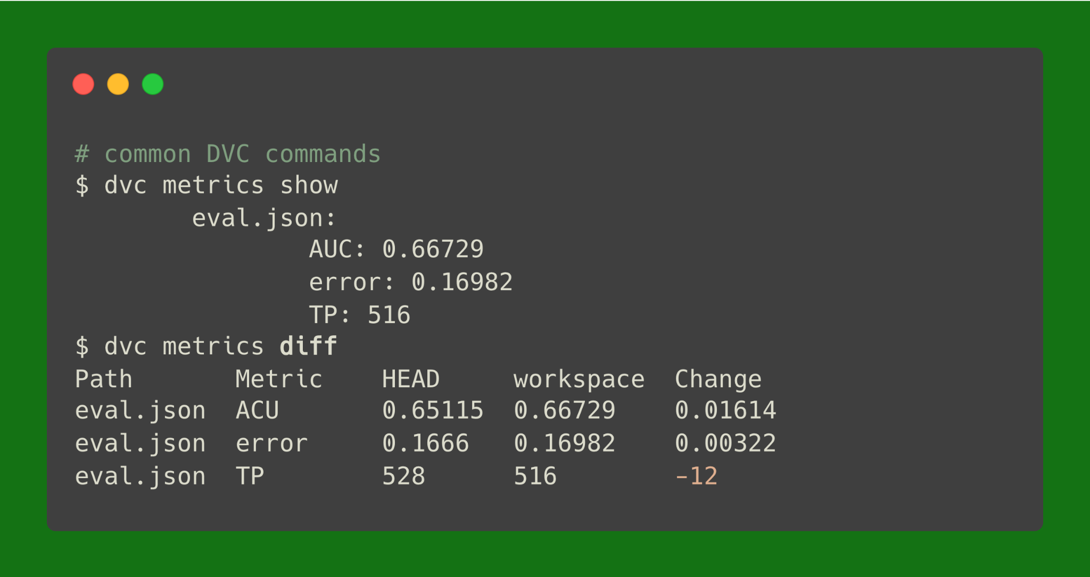
4. Results (performance metrics)

Slide 18
Let’s walkthrough an example

Slide 19
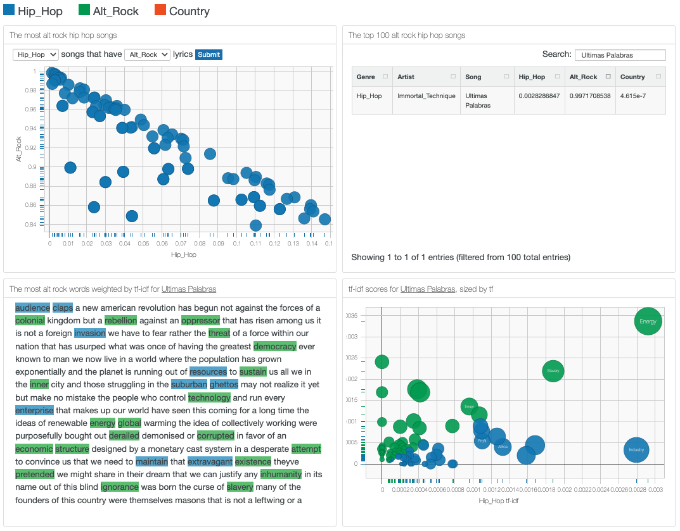
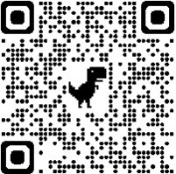
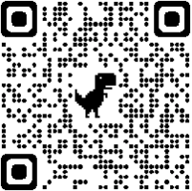
Predicting a song’s genre given its lyrics
← Link to blog
← Link to code

Slide 20
Setting up the environment

Slide 21
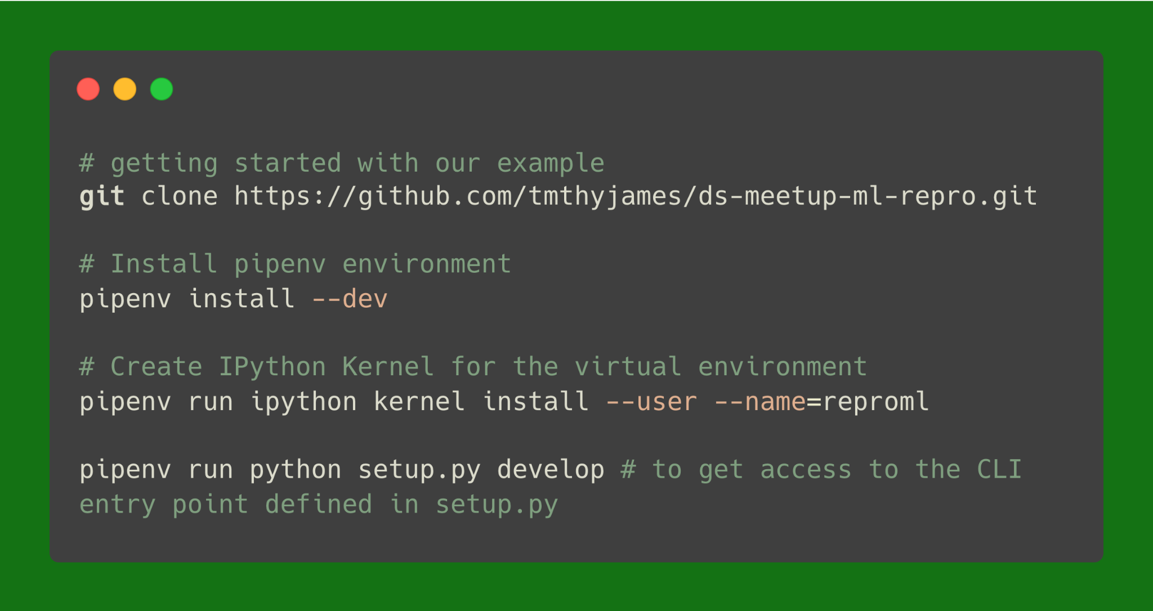
Setting up the environment

Slide 22
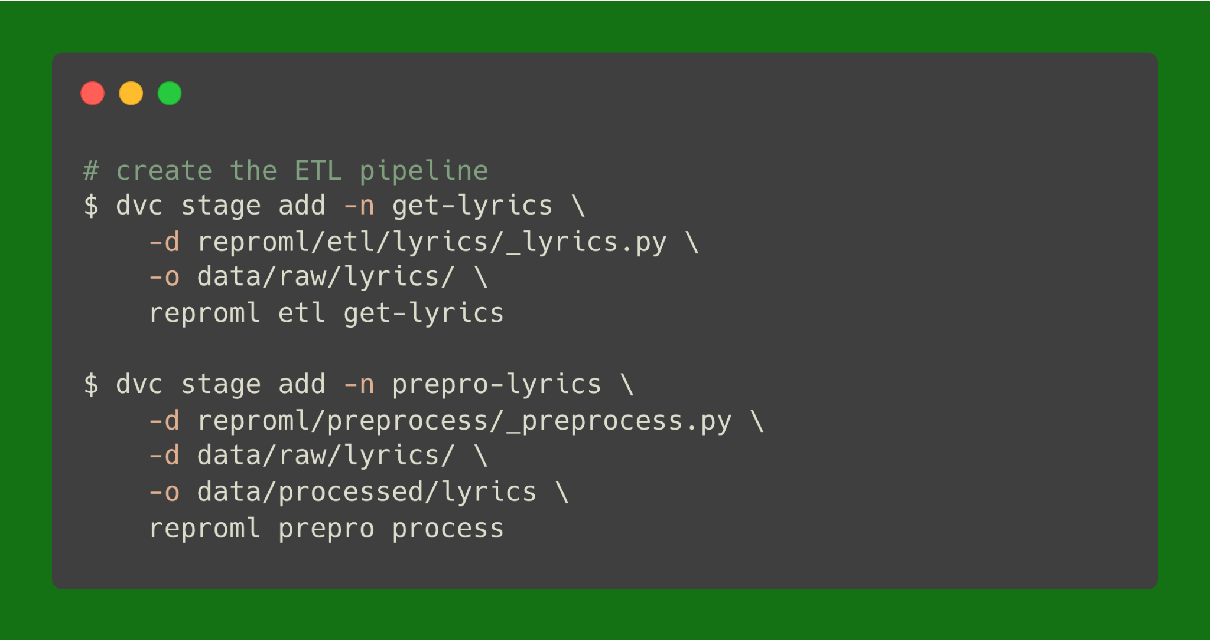
Creating the ETL pipeline using DVC

Slide 23
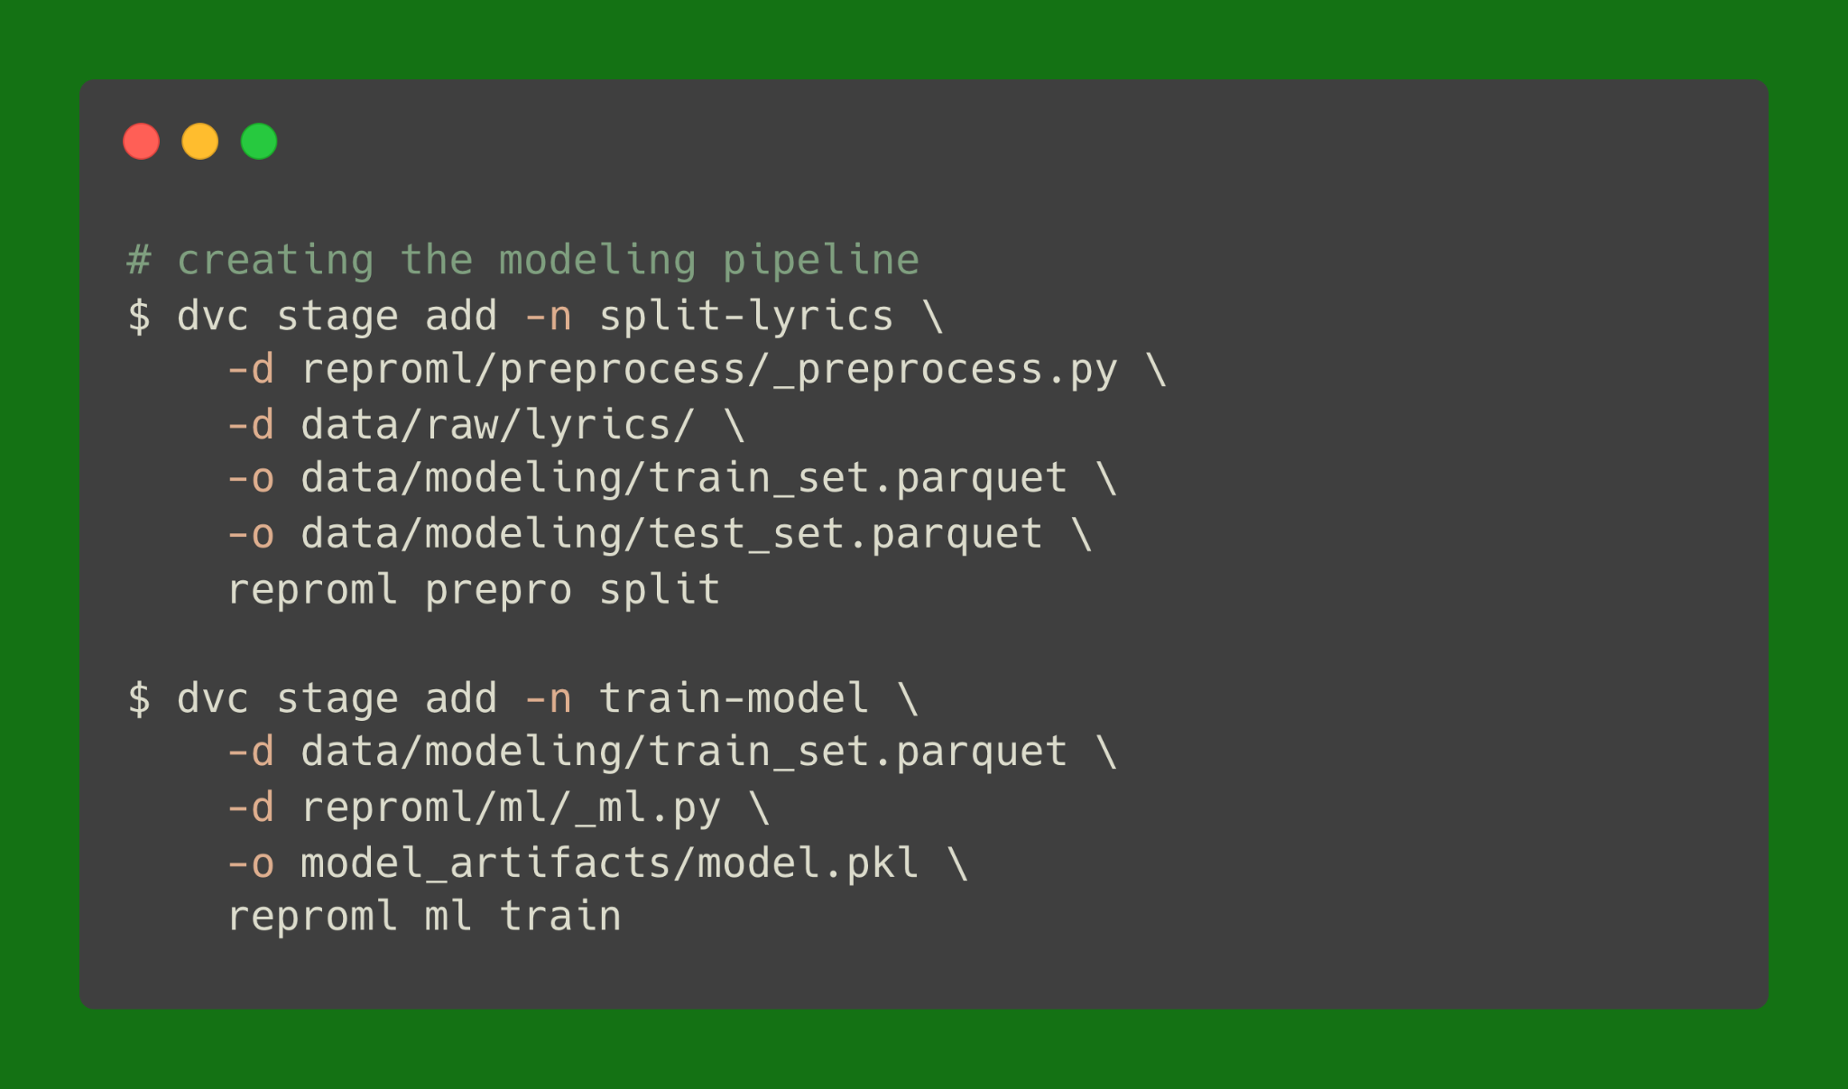
Creating the modeling pipeline using DVC

Slide 24
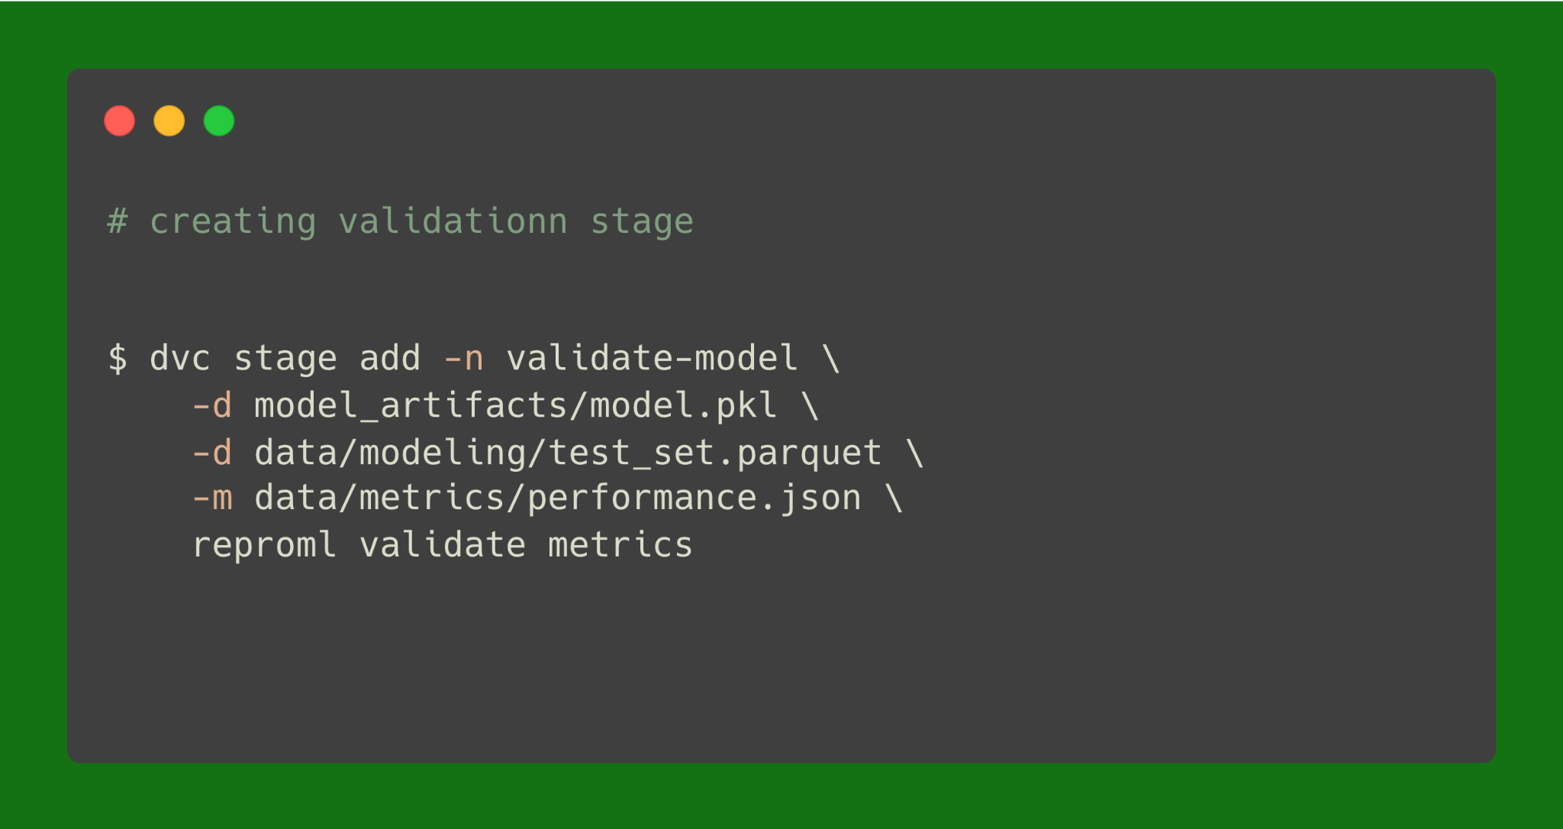
Creating the validation stage using DVC

Slide 25
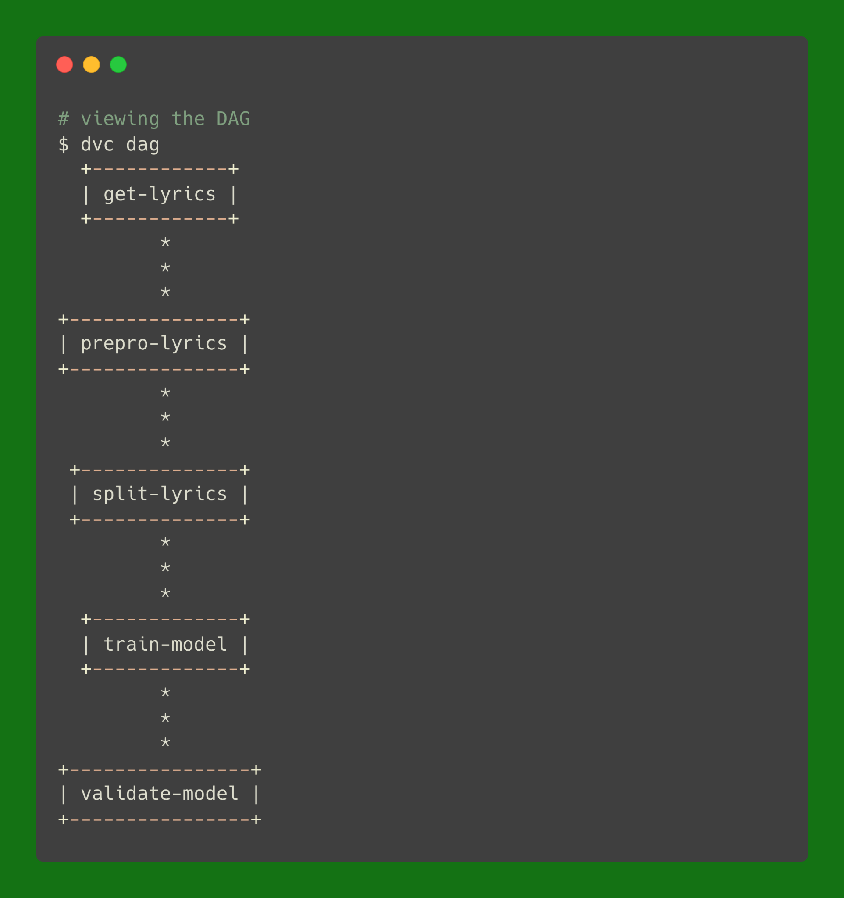
Now we can view our DAG

Slide 26
Now DVC knows how to track our pipeline
DVC will track changes
DVC will add all tracked files to a remote storage
DVC knows how to handle branches

Slide 27
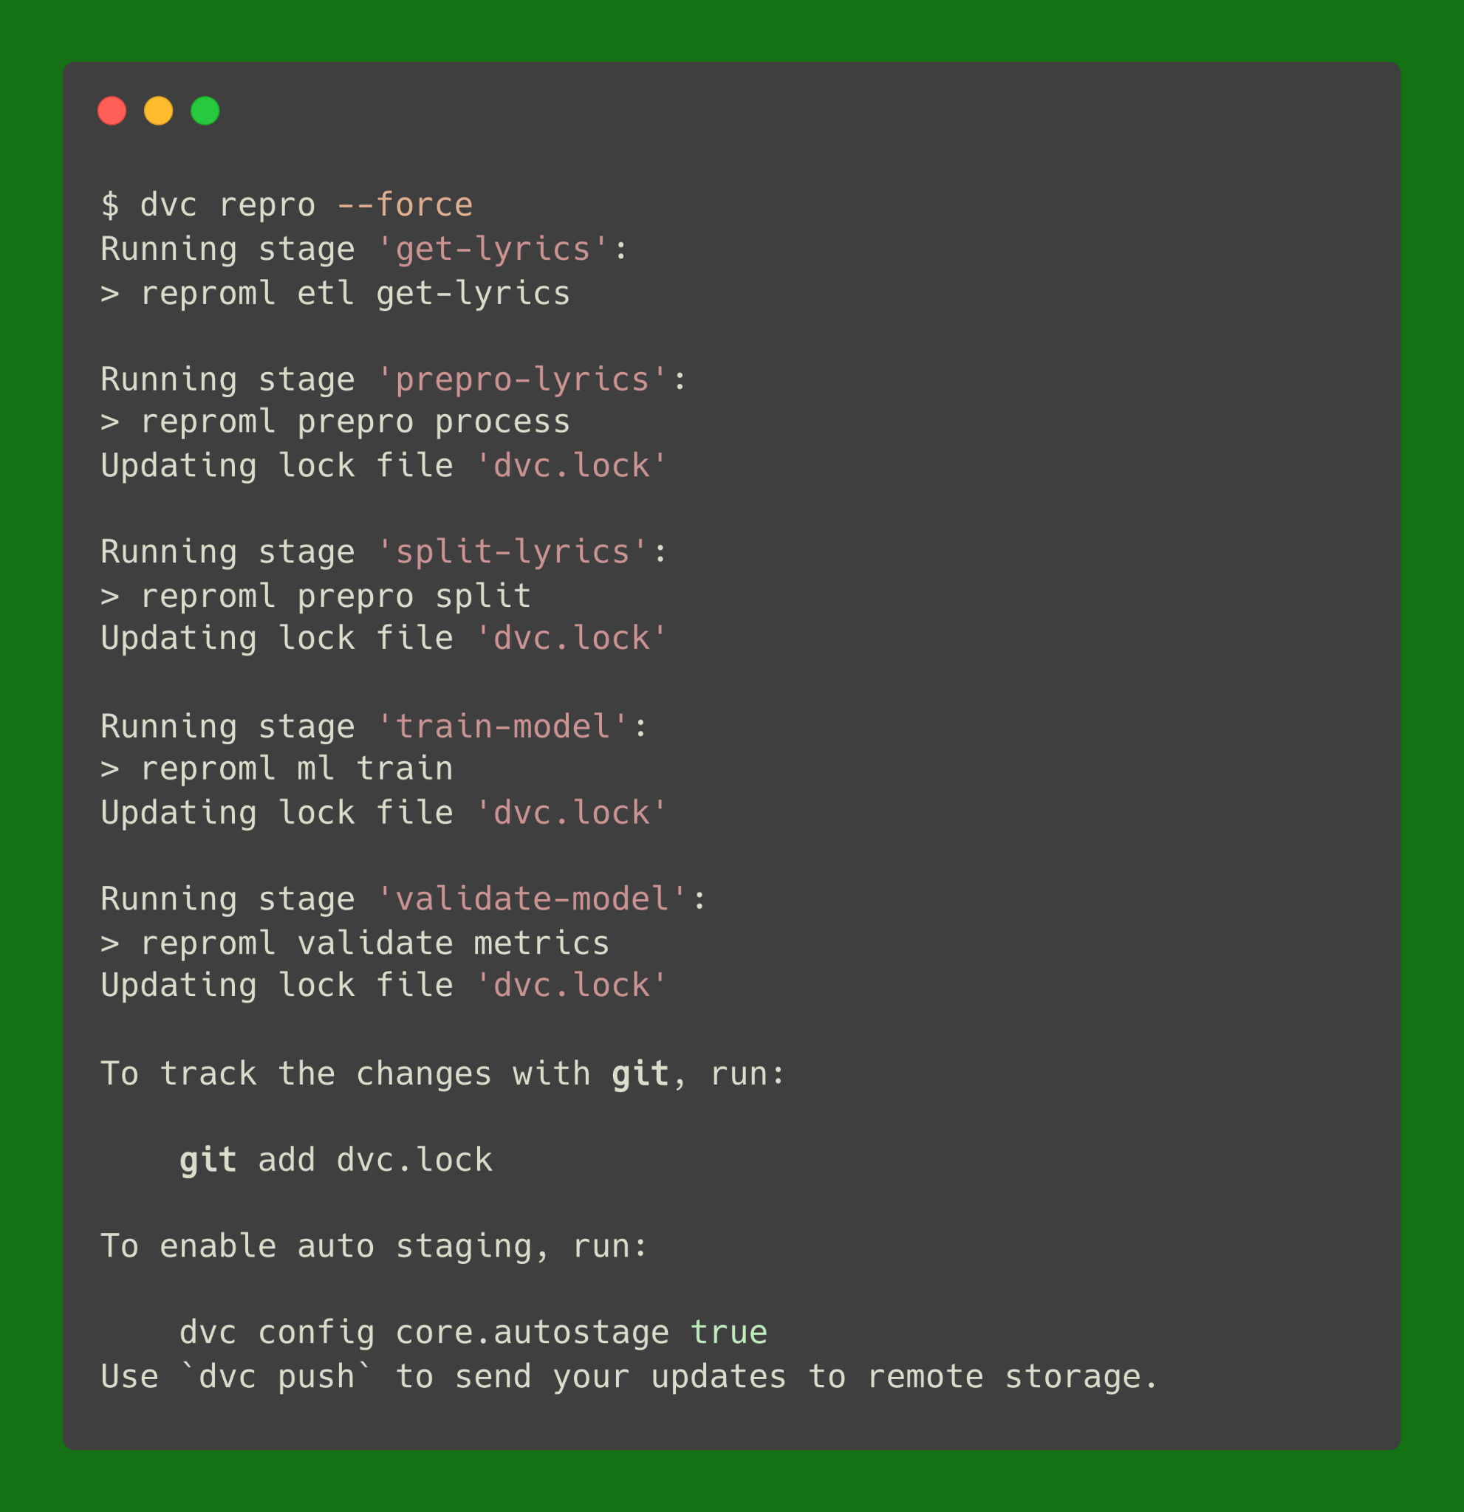
Let’s run the pipeline

Slide 28
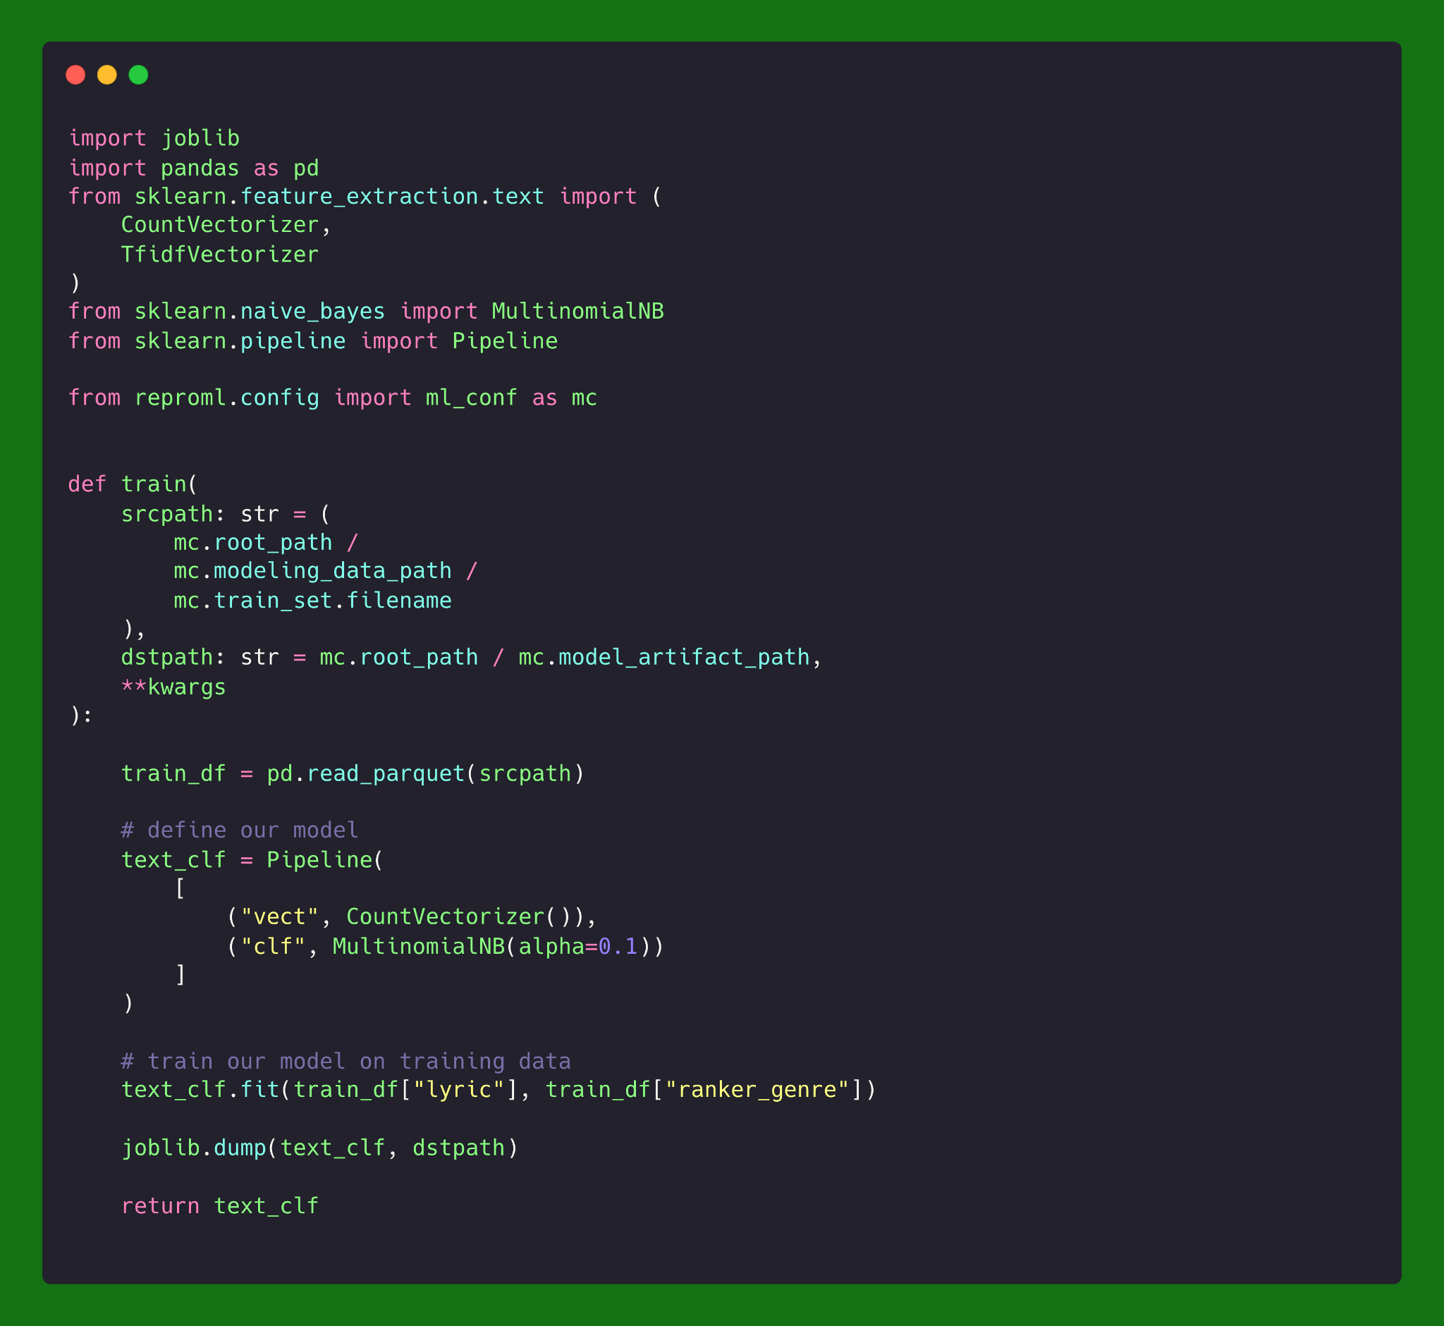
Here’s our model training code

Slide 29
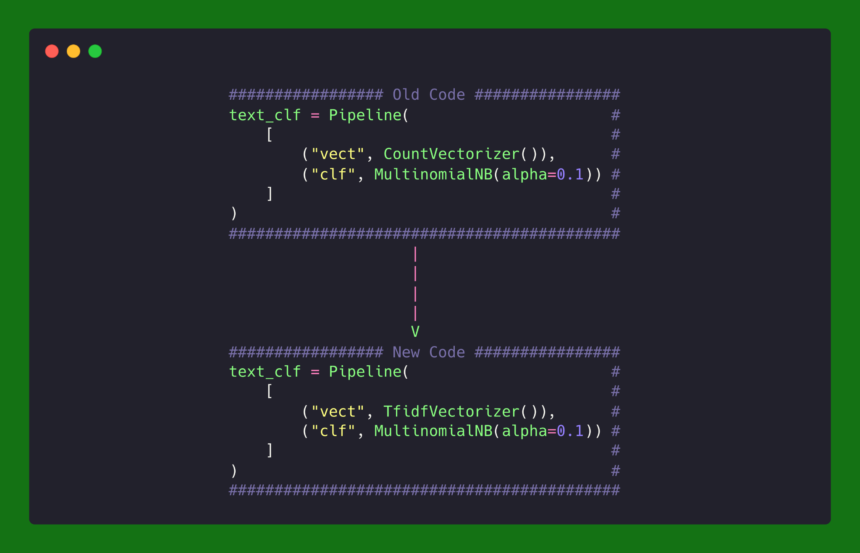
We’re going to change our training code

Slide 30
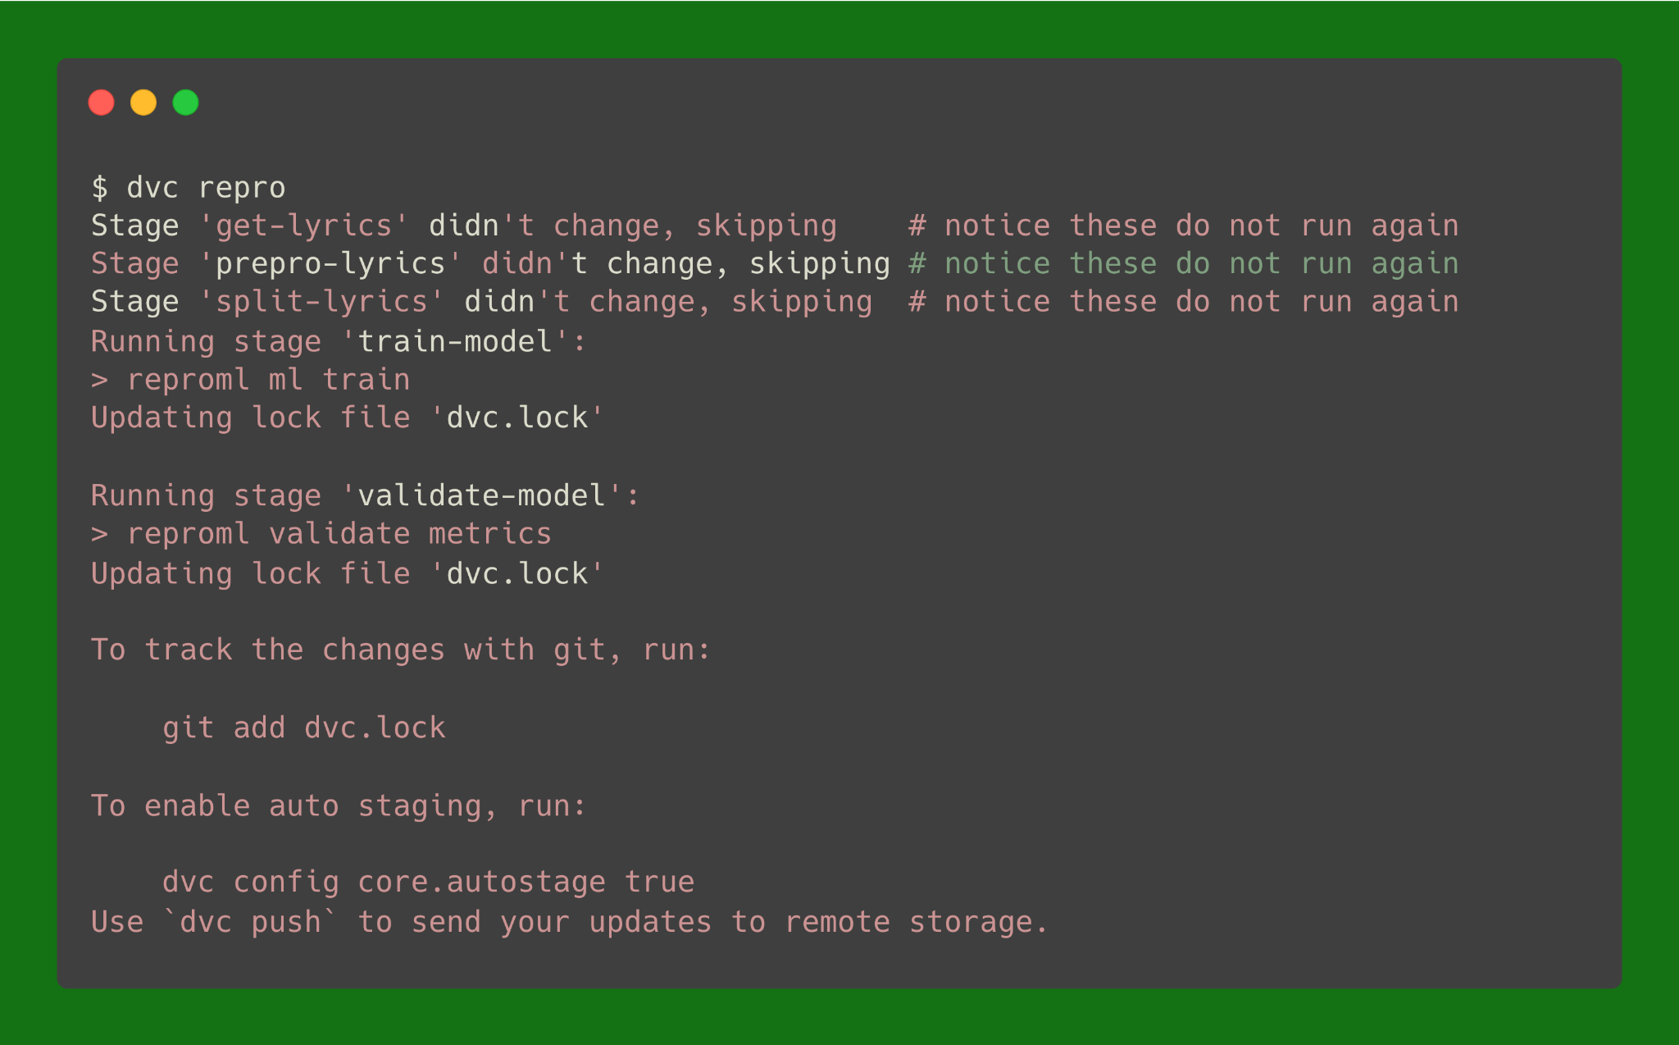
And rerun dvc repro

Slide 31
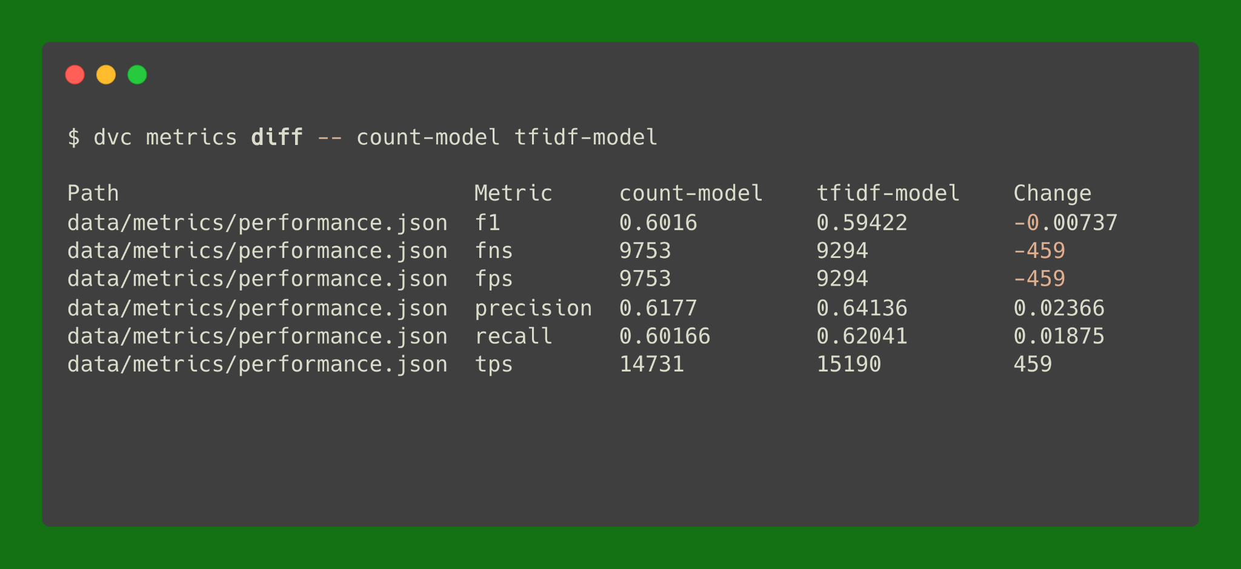
Now let’s compare metrics

Slide 32
To close…
5 reasons to care about reproducibility in ML
Collaboration, Debugging, Validation, Auditing, Legacy
4 components to account for
Environment, Code, Data, Metrics

Slide 33
Questions?
Code and slides on Github

Slide 34

Let’s connect!

